Slide 1


NVIDIA-KLE Tech.
IMAGE DEGRADATION TOOL
KLE Tech Mentor | Nalini C Iyer , Basawaraj Patil
NVIDIA Mentor | Robin Jenkin
Student Team | Mayur Patil 01FE22BEC438 Ryan Fernandes 01FE21BEC006 Adnan Ahmed Mirji 01FE22BEC428 Shaheed Akhtar Chikkumbi 01FE22BEC429 Gousekhan S Karmadi 01FE22BEC434
20th May 2024

Slide 2
Title: Image Degradation Tool
Problem Statement: Develop a framework to introduce known degradation in the clean test image.
Objectives:
Add known Lens Shading and Inverse CCM.
Build an application or GUI to generate degraded image with the known degradation model.
Should be able to bulk process directory of images.
Image Degradation Models:
Lens Shading
Inverse CCM

Slide 3

Title: Image Degradation Tool
Proposed Framework
IMAGE DEGRADATION TOOL
MTF
INVERSECCM
QE
LENS SHADING
VEILING GLARE
PTC
SOURCE FOLDER
DESTINATION FOLDER

Slide 4






Title: Image Degradation Tool
Work done:
Natural Shading:
Linear lens Shading: Center fixed
R – 0.7
G – 0.6
B – 0.4
Input image
Output image
Input Image
Output Image
Linear lens Shading: Center shifted
Input Image
Output Image

Slide 5
Title: Image Degradation Tool
What is CCM:
A color correction matrix is a mathematical transformation used in digital imaging to adjust the color of an image or video. It's a key component of color management systems and is particularly important in industries like photography, cinematography, and computer graphics.
Why we need CCM:
Color Accuracy
Color Balancing
Color Matching
Standardization
Creative Control

Slide 6
Title: Image Degradation Tool
What is inverse CCM:
An inverse color correction matrix, also known as a "decolorization matrix" or "color restoration matrix," is used in the context of image processing to reverse the effects of color correction applied to an image. It's essentially the opposite transformation of a color correction matrix.
Why we need inverse CCM:
Color Accuracy
Error Correction
Image Restoration
Modelling Transformations
Quality Assessment

Slide 7
Title: Image Degradation Tool
Inverse CCM:
Given CCM Matrix:
Inverse CCM Matrix:
 | Red | Green | Blue
Red out | 0.641 | 0.397 | -0.039
Green out | 0.205 | 1.120 | -0.325
Blue out | 0.026 | -0.278 | 1.252
Red | Green | Blue
0.2318 | 0.1180 | 0.1522
0.2151 | 0.9505 | 0.2653
0.4776 | 0.1475 | 0.0110
Inverse of matrix

Slide 8
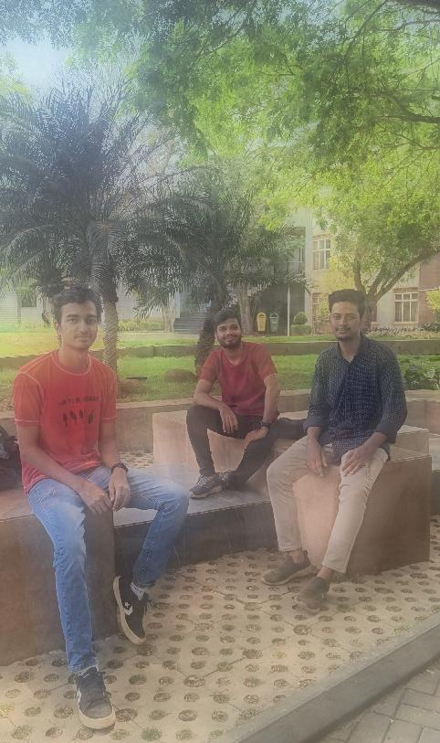

Title: Image Degradation Tool
Inverse CCM:
Inverse with white balance
INPUT IMAGE
OUTPUT IMAGE

Slide 9


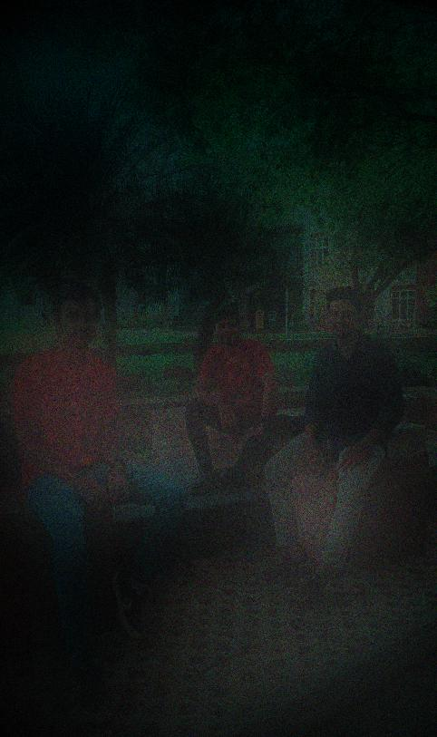


Title: Image Degradation Tool
Original image
MTF
Inverse CCM
QE
PTC
Veiling glare
Lens shading

Slide 10
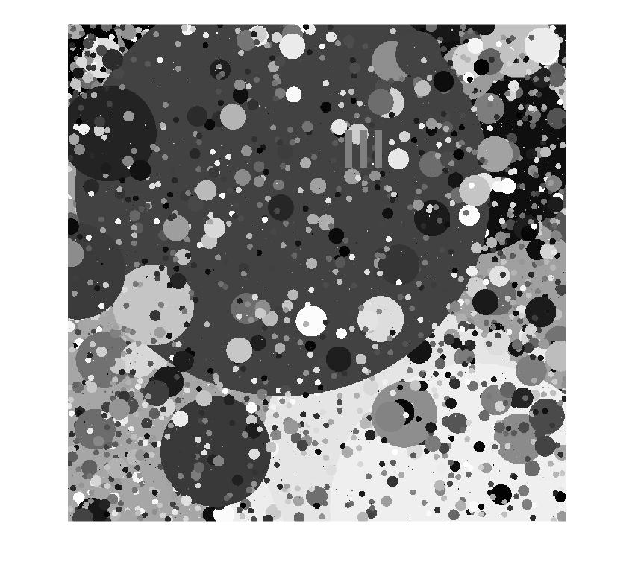
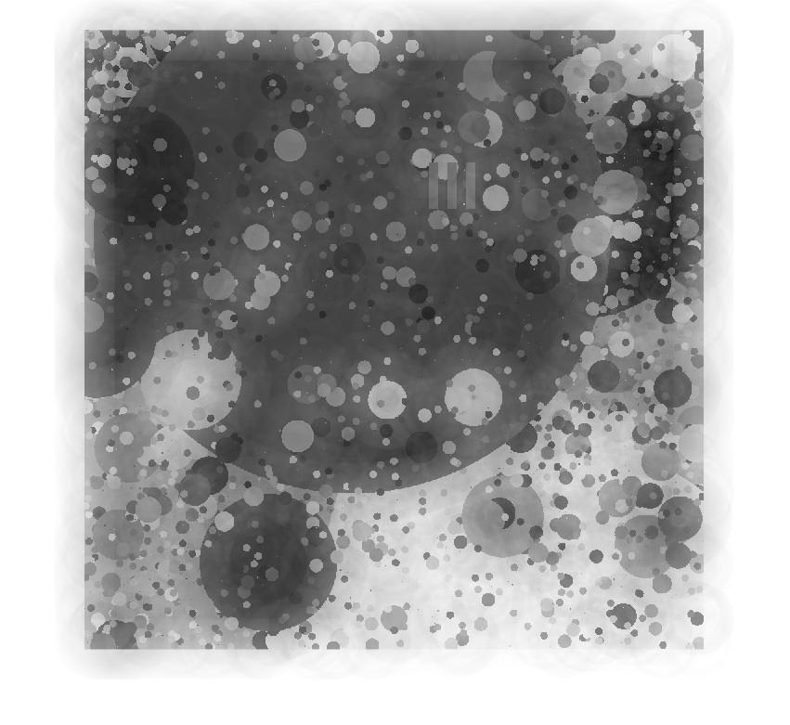
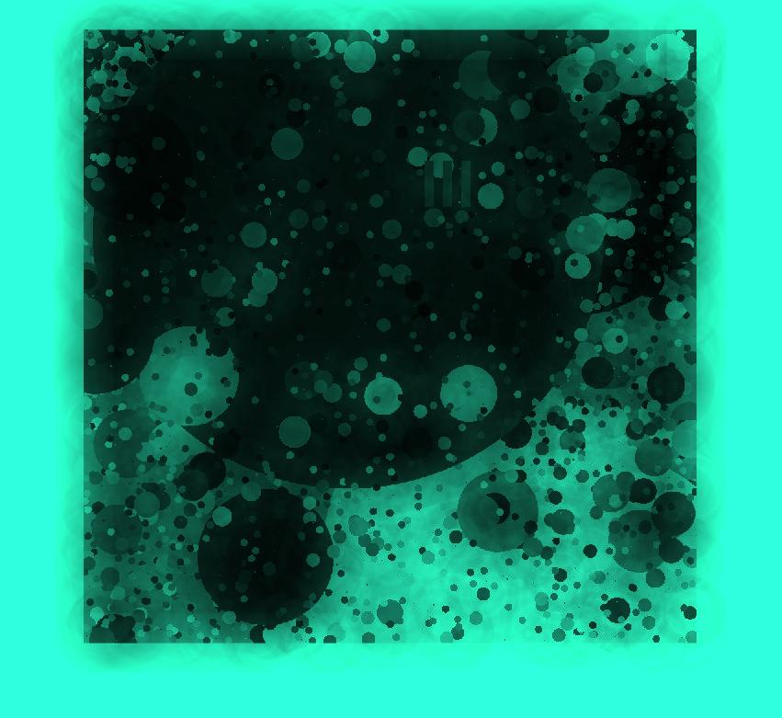
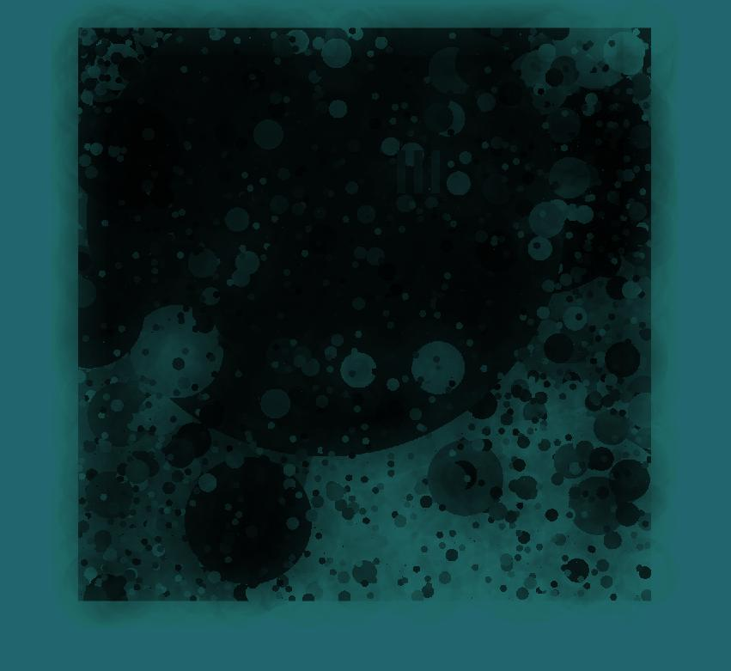
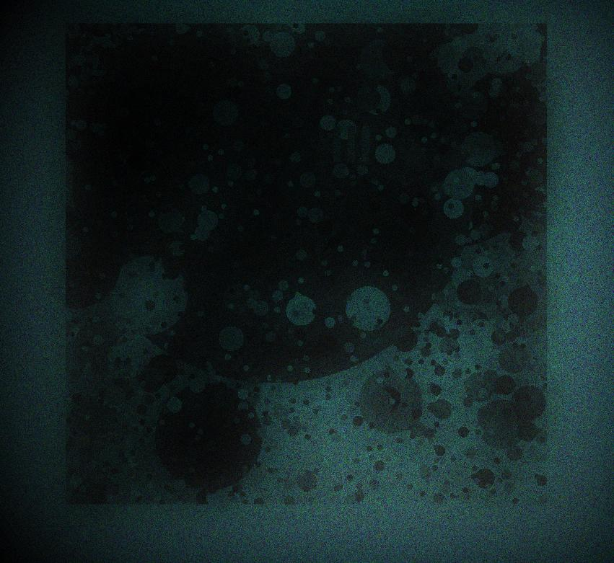

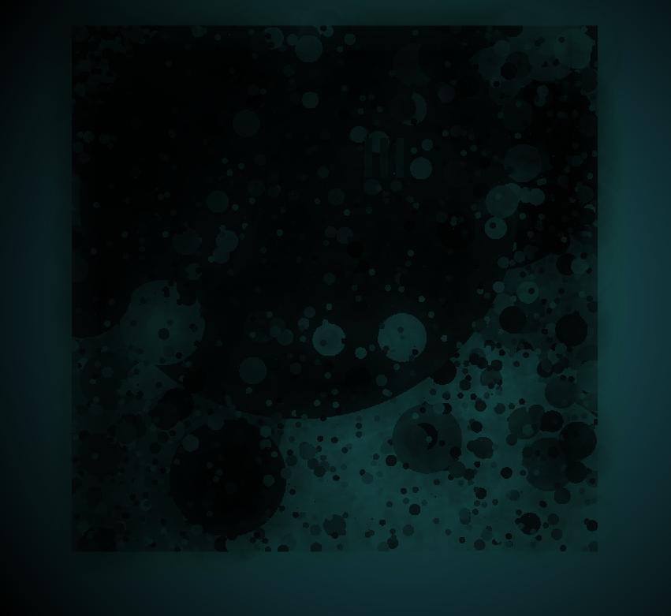
Title: Image Degradation Tool
Original image
MTF
Inverse CCM
QE
PTC
Veiling glare
Lens shading

Slide 11
PTC DEGRADED IMAGE
QE
ORIGINAL IMAGE
VAILING GLARE
MTF
LENS SHADING
INVERSE CCM

Slide 12
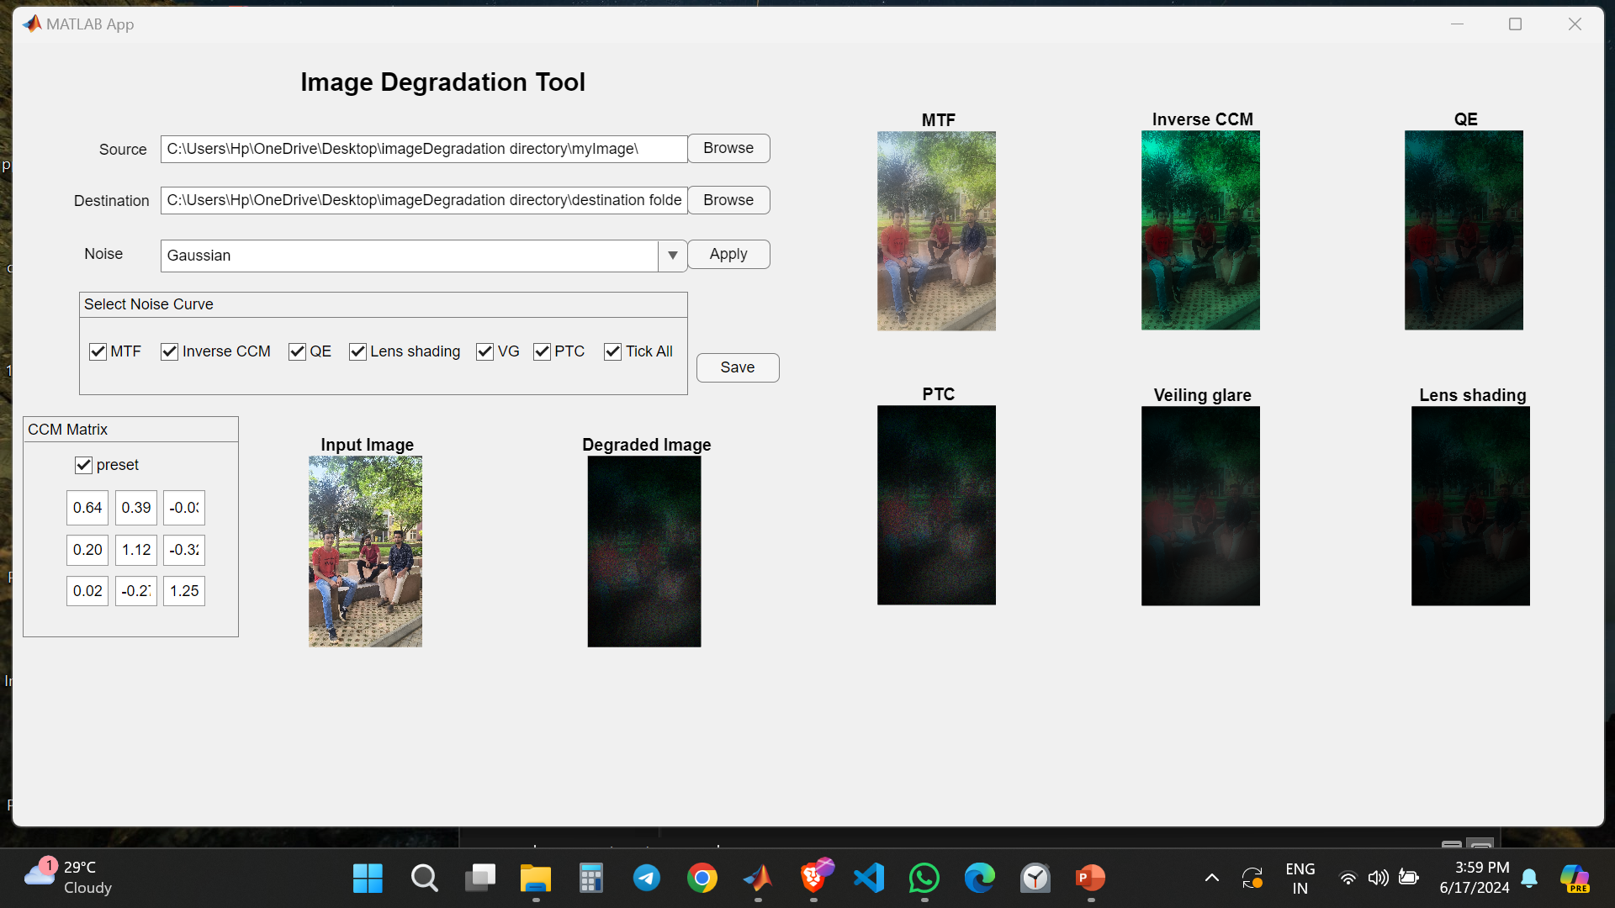
Title: Image Degradation Tool
GUI(matlab app):-

Slide 13
Title: Image Degradation Tool
Thank You

